Slide 1
Part I Syllabus – Fundamental Underlying Layers
Date​ | Subject​ | File​
Week 1:​ 9/Jan/2023​ 11/Jan/2023​ | Introduction: course logistics and Internet history​ | M1-L1-Introduction.pptx​
 | Layered Network Architecture​ | First part of M1-L2-Network Layer & Physical Resilience.pptx​
Week 2:​ 16/Jan/2023​ 18/Jan/2023​ | Physical Layer: Network Resilience​ | Second part of M1-L2-Network Layer & Physical Resilience.pptx​
 | Data link layer – Flow control​ | M1-L3-DLL-Flow Control.pptx​
Week 3:​​ 25/Jan/2023​ | Data link layer – Error control​ | M1-L4-DLL-Error Control.pptx​
Week 4:​ 30/Jan/2023​ 01/Feb/2023​ | Local area network – Introduction​ | M1-L5-LAN-Introduction.pptx​
 | Local area network – MAC​ | M1-L6-LAN-MAC.pptx​
Week 5:​ 06/Feb/2023​ 08/Feb/2023​ | Local area network – Ethernet​ | First part of M1-L7-LAN-Ethernet.pptx​
 | Local area network – Ethernet Evolutions​ | Second part of M1-L7-LAN-Ethernet.pptx​
Week 6:​ 13/Feb/2023​ 15/Feb/2023​ | Local area network – WLAN​ | M1-L8-LAN-WLAN.pptx​
 | Mobile Access Networks | M1-L9-Mobile.pptx
Week 7: 20/Feb/2023 22/Feb/2023 | E-learning for Network paradigms | M1-L10-Paradigms.pptx
 | Reviewing all contents taught in previous lectures

Slide 2
Additional Materials
The related content talked today in https://eclass.teicrete.gr/modules/document/file.php/TP326/%CE%98%CE%B5%CF%89%CF%81%CE%AF%CE%B1%20(Lectures)/Computer_Networking_A_Top-Down_Approach.pdf is as follows:
MAC protocols: page 445 - page 449
ALOHA protocols: page 450 - page 453
CSMA and CSMA/CD protocols: page 453 - page 459
You can also find video materials:
ALOHA https://www.youtube.com/watch?v=j4-r0e7DjqY
CSMA/CD https://www.youtube.com/watch?v=iKn0GzF5-IU

Slide 3

How to mingle among cocktail
When to start speaking?
What to speak?
Whether/How to react to interruption?

Slide 4

SC2008/CZ3006/CE3005 ​ Computer Network
Lecture 6
Medium Access Control (MAC) Protocols

Slide 5
Contents
Medium Access Control Protocol
Ideal MAC Protocol
MAC Taxonomy
ALOHA Protocols
Slotted ALOHA
Pure ALOHA
CSMA Protocol
Vulnerable time in CSMA
CSMA Variants
CSMA/CD Protocol
Collision Detection

Slide 6
Medium Access Control Protocols
Single shared broadcast channel
Two or more simultaneous transmissions
Collision if node receives two or more signals at the same time
MAC Protocol
Distributed algorithm to share the channel
Communication about channel sharing must use channel itself
No out-of-band channel for coordination

Slide 7

Ideal MAC Protocol
Broadcast Channel of Rate R-bps
When one node transmits, it can send at rate R
When M nodes want to transmit, each can send at average rate R/M
Full decentralized
No special node to coordinate transmissions
No synchronization of clocks, slots
Simple
We call this ideal protocol as “genie-aided” MAC

Slide 8
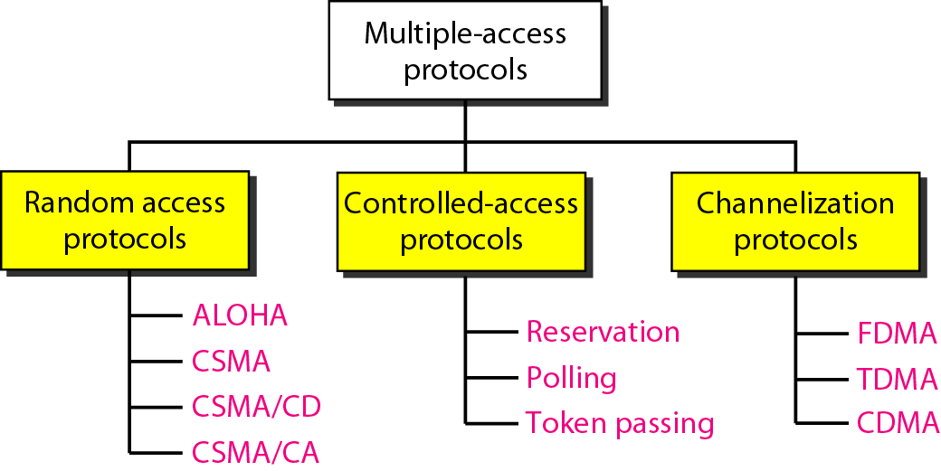
MAC Taxonomy
CSMA: Carrier Sense Multiple Access,
CSMA/CD: CSMA with Collision Detection,
CSMA/CA: CSMA with collision avoidance

Slide 9
Random Access Protocols
When node has packet to send
Transmits at full channel data rate of R
No a-priori coordination among nodes
Two or more transmitting nodes
Collision
Design of random MAC has 3 aspects
Whether to sense channel status
How to transmit frames
How to detect and react to collision (What to do with the collision)

Slide 10
ALOHA Protocols
aloha
/əˈləʊhə/
exclamation & noun
a Hawaiian word used when greeting or parting from someone.

Slide 11
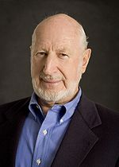
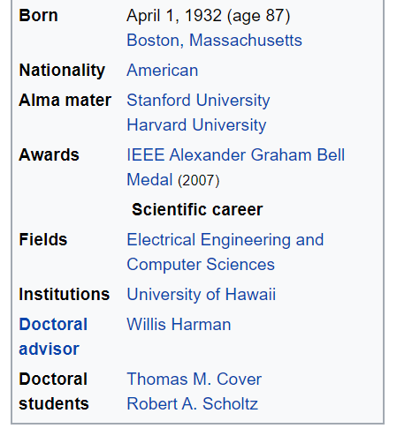
ALOHA
Inventor
Norm Abramson
Assumptions
All frames of the same size
Time is divided into equal size slots, time to transmit 1 frame
Nodes are synchronized
Nodes start to transmit frames only at beginning of slots
If 2 or more nodes transmit in slot, all nodes detect collision

Slide 12
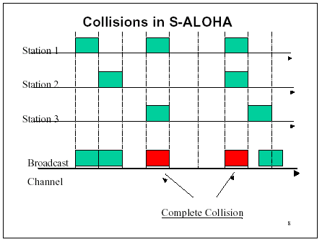
Slotted ALOHA
time

Slide 13
Slotted ALOHA Efficiency
Result of a slot
Successful (S): only one node transmits
Collision (C): 2⁺ nodes transmits
Empty (E): no transmission
If, there are N nodes and in each slot, each node transmits with probability p
If a node i transmits, the probability that the transmission is successful is Pr(S_{i}) = p (1-p)^{(N-1)}
The probability that a slot is successful is Pr(S) = Pr(S₁) + Pr(S₂) + … + Pr(S_{N}) = N p (1-p)^{(N-1)}

Slide 14
Slotted ALOHA Efficiency
An example of 4-node network
4 cases for a successful slot
Tx
No Tx
Case 1
Case 2
Case 3
Case 4
probability
p(1-p)³
p(1-p)³
p(1-p)³
p(1-p)³
Pr(S) = 4p(1-p)³

Slide 15
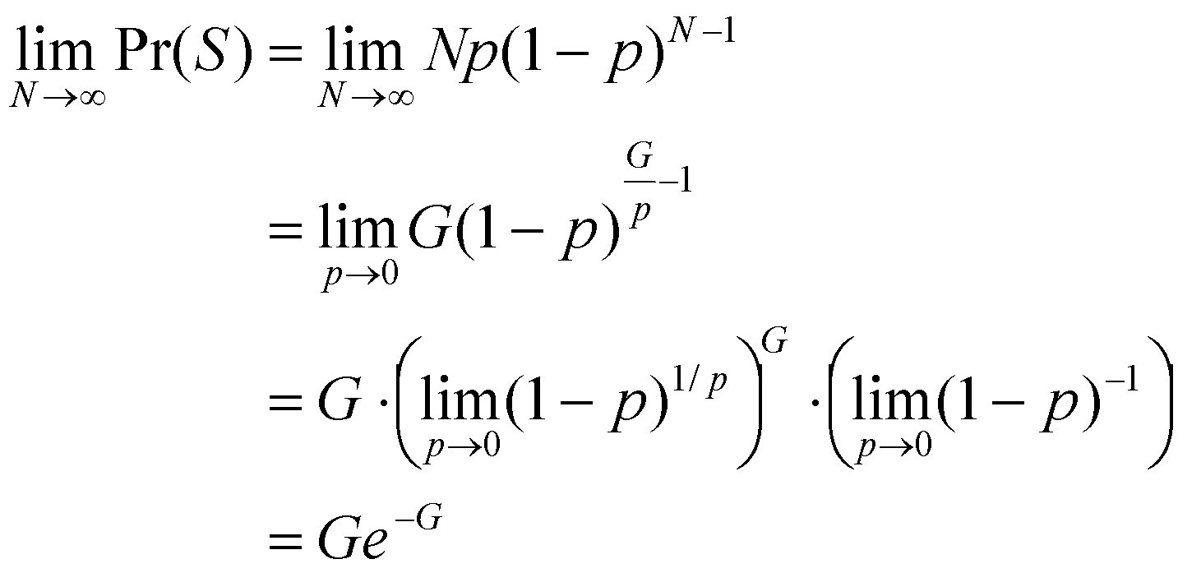


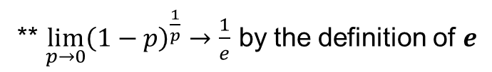
Slotted ALOHA Efficiency
Offered load G = Np
Expected total number of transmissions in a slot
Slotted ALOHA efficiency when N is large
*
**

Slide 16
Slotted ALOHA Efficiency
(1, 1/e)
Throughput
Offered load G
Pr(S) is throughput in frames per frame time
Pr(S) <= 1/e (≈ 0.37) **
1/e achieved when G = 1
At the same time, Pr(E) ≈ 0.37, Pr(C) ≈ 0.26
** Tutorial 3.5

Slide 17
Pros and Cons of Slotted ALOHA
Pros
Single active node can continuously transmit at full rate of channel
Highly decentralized: only slots need to be sync
Simple
Cons
Collisions, wasting slots
Empty slots
Clock synchronization

Slide 18
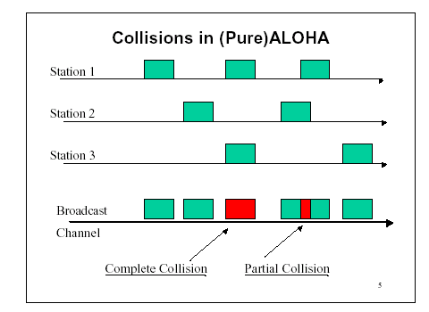
Pure ALOHA
In pure ALOHA, frames are transmitted at completely arbitrary times

Slide 19
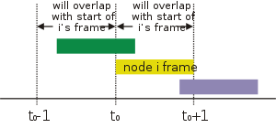
Pure ALOHA
Unslotted Aloha: simpler, no synchronization
When frame first arrives
Transmit immediately
Collision probability increases:
Frame sent at t₀ collides with other frames sent in [t₀-1, t₀+1]

Slide 20
Aloha Efficiency: Pure ALOHA
Pure Aloha: Partial transmission collision can occur (i.e., my 1st half of the transmission collides with your 2nd half)
Pr( success by given node) = P(node transmit) *
P( no other node transmits in [t₀-1, t₀]) *
P(no other node transmit in [t₀, t₀+1])
= p x (1-p)^{(N-1)} x (1-p)^{(N-1)}
= p (1-p)^{(2N-2)}
So for the network, Pr(S) = N p (1-p)^{(2N-2)}
For very large N, Pr(S) = Ge^{-2G}, where G=Np is the offered load
Therefore, Pr(S) <= 1/(2e) = 18.4%

Slide 21
ALOHA Efficiency Comparison
0.4
0.3
S = throughput =(success rate)
Slotted Aloha
0.2
Ge^{-G}
0.1
Pure Aloha
Ge^{-2G}
0.5
1.0
1.5
2.0
G = offered load rate
= Expected total frames presented to the link per
the transmission time of a single frame

Slide 22
Carrier-Sense Multiple-Access (CSMA)

Slide 23
Carrier-Sense Multiple-Access
To improve performance, avoid transmissions that are certain to cause collisions
Based on the fact that in LAN propagation time is very small
If a frame was sent by a station, all stations knows immediately so they can wait before start sending
A station with frames to be sent, should sense the medium for the presence of another transmission (carrier) before it starts its own transmission
This can reduce the possibility of collision but it cannot eliminate it.
Collision can only happen when more than one station begin transmitting within a short time (the propagation time period)

Slide 24
CSMA Variants
Different CSMA protocols that determine:
What a station should do when the medium is idle?
What a station should do when the medium is busy?
Three Types of CSMA Protocols
Non-persistent CSMA
1-Persistent CSMA
P-Persistent CSMA

Slide 25
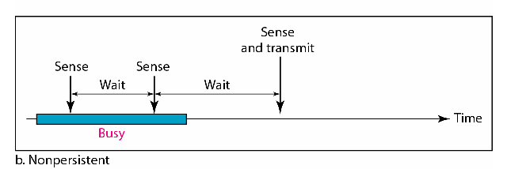
Non-persistent CSMA
A station with frames to be sent, should sense the medium
If medium is idle, transmit; otherwise, go to 2
If medium is busy, (backoff) wait a random amount of time and repeat 1
Non-persistent Stations are deferential (respect others)
Performance:
Random delays reduces probability of collisions because two stations with data to be transmitted would wait for different amount of times.
Bandwidth is wasted if waiting time (backoff) is large because medium will remain idle following end of transmission even if one or more stations have frames to send

Slide 26
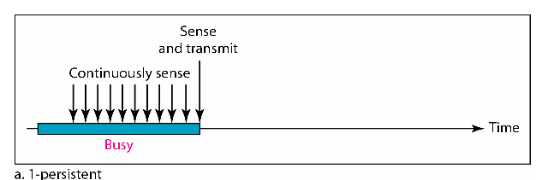
1-Persistent CSMA
To avoid idle channel time, 1-persistent protocol used
Station wishing to transmit listens to the medium:
If medium idle, transmit immediately;
If medium busy, continuously listen until medium becomes idle; then transmit immediately with probability 1
1-persistent stations are selfish
Performance
If two or more stations becomes ready at the same time, collision guaranteed

Slide 27
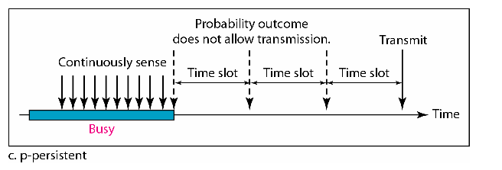
P-Persistent CSMA
Time is divided to slots where each time unit (slot) typically equals maximum propagation delay
Station wishing to transmit listens to the medium:
If medium idle,
transmit with probability (p), OR
wait one time unit (slot) with probability (1 – p), then repeat 1.
If medium busy, continuously listen until idle and repeat step 1
Performance (wise guy)
Reduces the possibility of collisions like non-persistent
Reduces channel idle time like 1-persistent

Slide 28
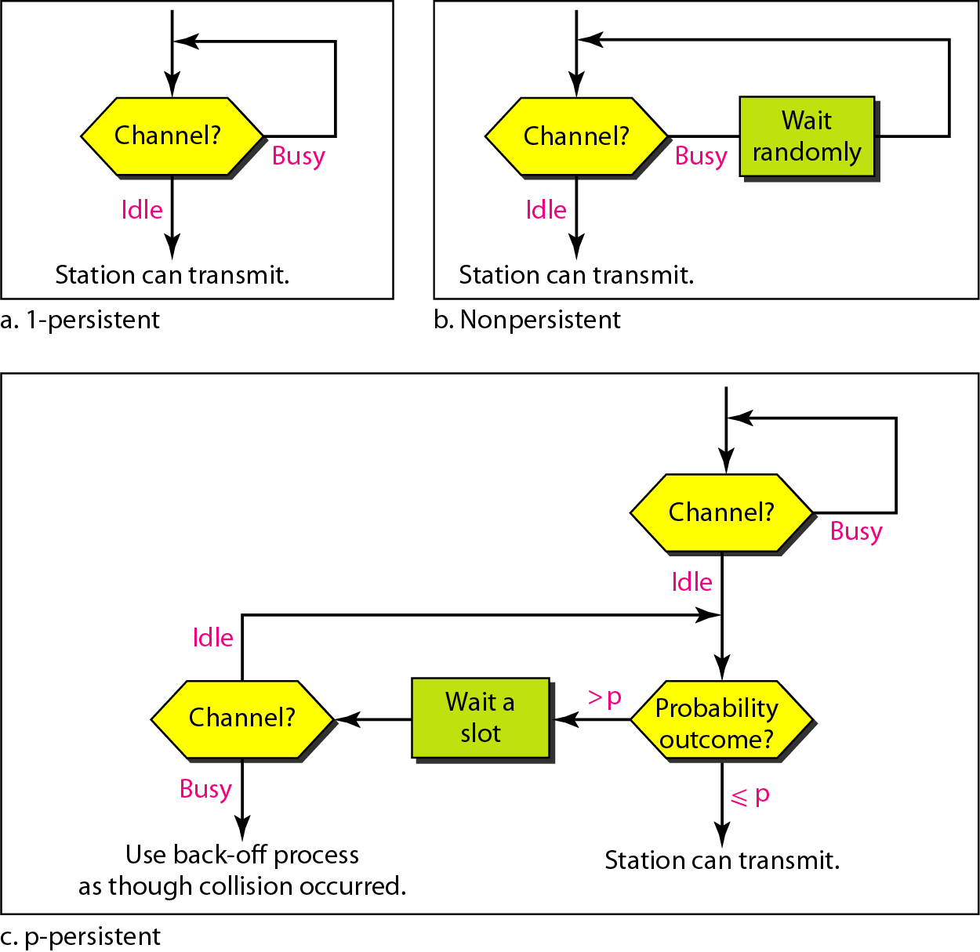
Flow Diagrams for CSMA

Slide 29
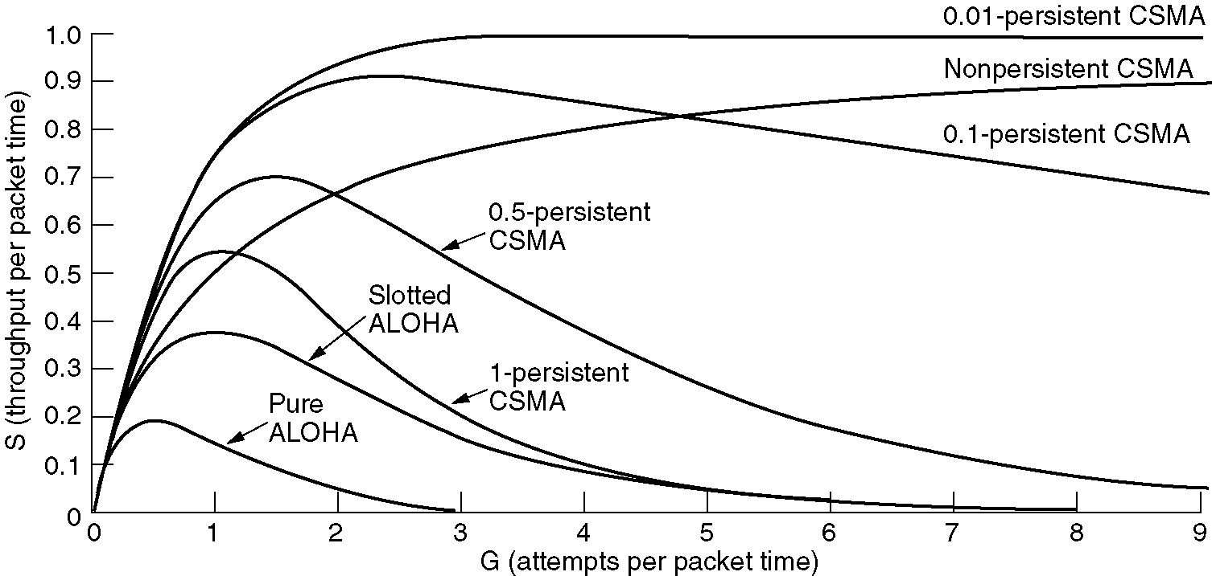
CSMA Efficiency
Comparison of the channel utilization versus load for various random access protocols.

Slide 30
CSMA/CD Protocol

Slide 31

Collision in CSMA
3. Collision occurs at this place on the medium
A
B
C
1. A senses the medium idle and starts transmission
2. C senses the medium idle and starts transmission
5. A detects the collision
4. C detects the collision
Time

Slide 32
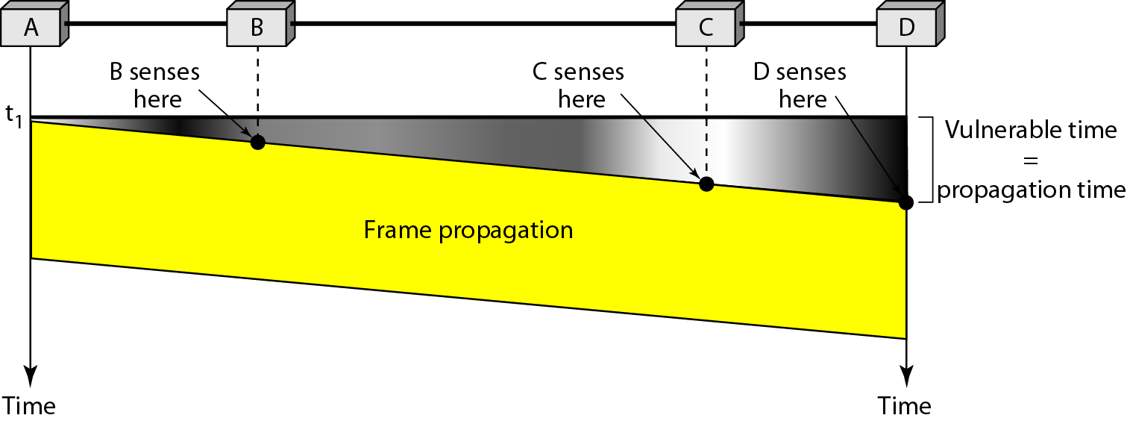
Vulnerable Time in CSMA
Vulnerable time for CSMA is the maximum propagation time
The longer the propagation delay, the worse the performance of the protocol.

Slide 33
CSMA/CD (Collision Detection)
CSMA has channel wastage
If a collision has occurred, colliding packets are still to be fully transmitted.
CSMA/CD (Carrier Sense Multiple Access with Collision Detection) overcomes this:
While transmitting, the sender is listening to medium for collisions.
Sender stops transmission if collision has occurred, reducing channel wastage.
CSMA/CD is widely used for bus topology LANs (IEEE 802.3, Ethernet)

Slide 34
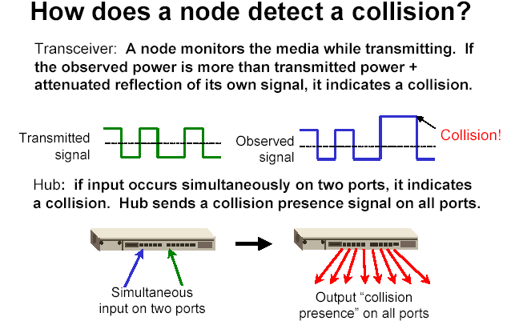
How to detect a Collision?
Transceiver
A node monitors the media while transmitting. If the observed power is higher than the transmitted power of its own signal, it means collision occurred.
Hub
If input occurs simultaneously on two ports, it indicates a collision. Hub send a collision presence signal on all ports.

Slide 35
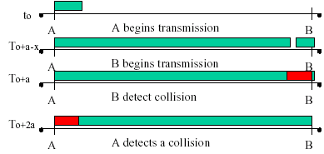
Collision Detection
Question: How long does it take to detect a collision?
Answer: In the worst case, twice the maximum propagation delay of the medium
Note: a = maximum propagation delay

Slide 36
CSMA/CD Protocol
Transmission protocol
Use one of the CSMA persistent algorithms
If a collision is detected by a station during its transmission, it should do the following
Abort transmission, and
Transmit a jam signal (48 bits) to notify other stations of collision so that they will discard the transmitted frame also to make sure that the collision signal will stay until detected by the furthest station
After sending the jam signal, backoff (wait ) for a random amount of time, then
Transmit the frame again

Slide 37
Learning Objectives
ALOHA Protocol
Calculate throughput for ALOHA
Maximize throughput by differentiation
CSMA Protocol
Protocol comparison for three flavors
CSMA/CD Protocol
Maximum duration for collision detection

